Slide 1

myDegreePlan
Faculty/Staff Guide

Slide 2

myDegreePlan Log-In Procedure
Go to myWATC
Enter User Name and Password
Click Log-in to access the myWATC homepage
Click on the myDegree icon located in the upper right-hand corner

Slide 3
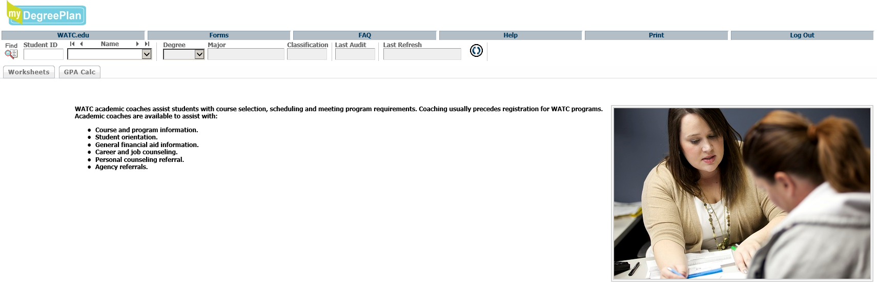
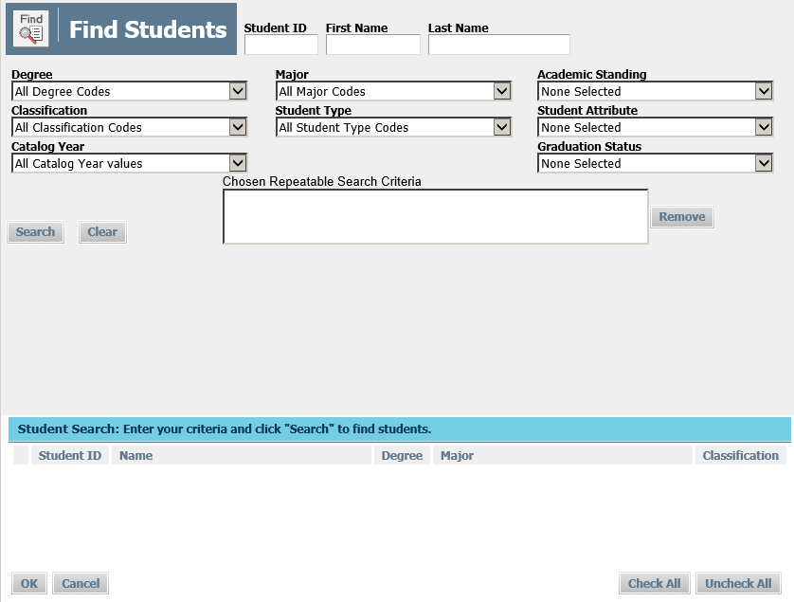
Search Screen
Here you can search by Student ID number, or if you don’t know it, click on the “Find” icon and a pop up screen will appear, allowing you to search by First and Last Name. You can also search for a group of students (ex: all students in a specific major).

Slide 4
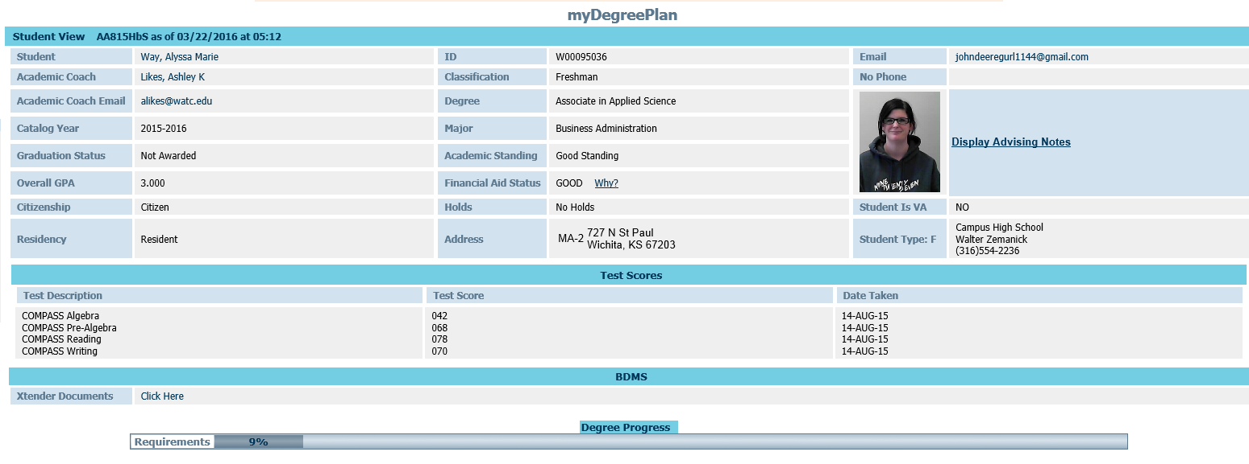

What is myDegreePlan?
Web-based tool to help students monitor their progress toward degree completion
Combines degree requirements and completed courses in the student audit worksheet
Shows courses/requirements still needed for degree completion

Slide 5
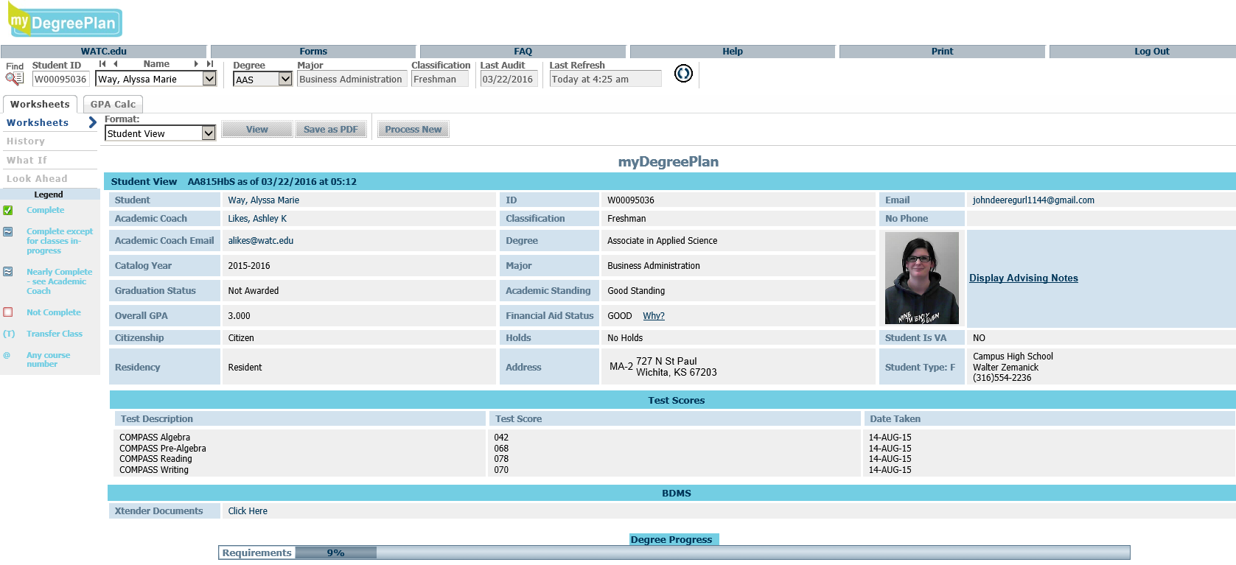
General Information Bar
Located across the top of the myDegreePlan audit page
Access links to WATC homepage, Forms, FAQs, Help, Print, and Log Out
General Information Bar

Slide 6
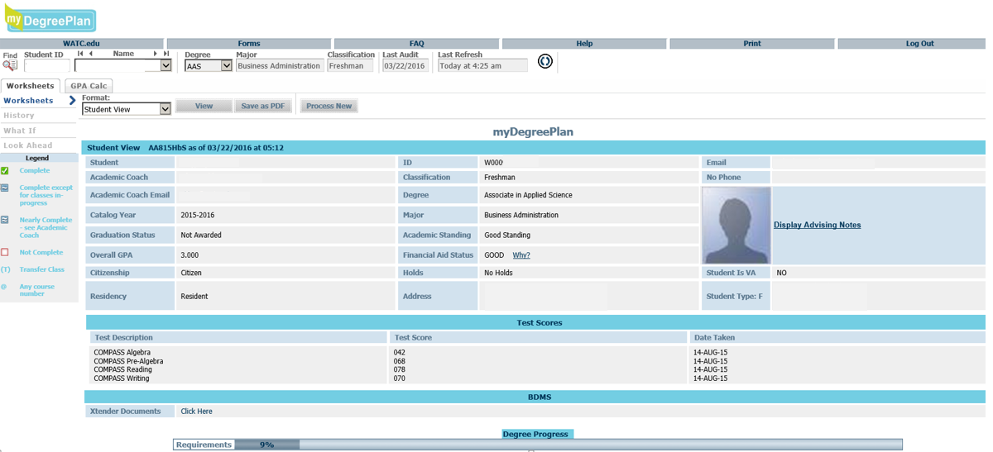
Student Information Bar
Located across the top of the myDegreePlan Audit page
  Under the General Information Bar
Contains all the same information as the Search Screen
  “Find” icon, Student ID, Name, Degree, Major, Classification, Last Audit date, Last Refresh date/time, and “Refresh” icon
Student Information Bar

Slide 7
Options Bar
Located across the top of the myDegreePlan Audit page
  Under the Student Information Bar
Includes Worksheets tab and GPA Calculator tab
Options Bar

Slide 8
Student Data Box
Displays various information such as Student ID, Academic Coach, Degree and Major, Catalog Year, Graduation Status, Academic Standing, Overall GPA, Holds, etc.
Student Data Box

Slide 9
Degree Progress Bar
Displays an estimate of a student’s degree completion percentage
Please note – this percentage is simply an estimation and is calculated from the number of checked boxes, and not the actual degree completion

Slide 10
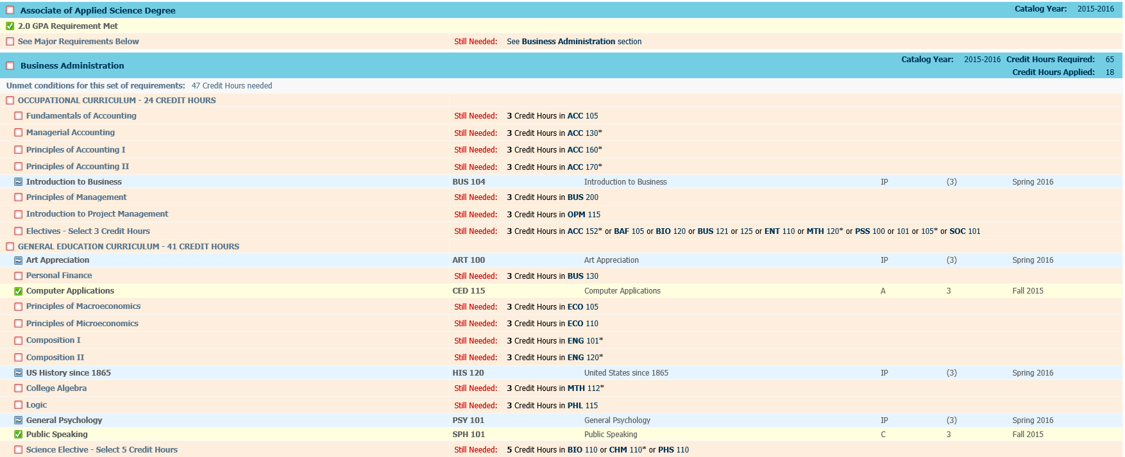
Degree Requirements Block
Major Requirements
General Education Requirements
Degree Requirements Block
Outlines course requirements that are completed, still needed, and/or in progress
Includes Major Requirements as well as General Education Requirements outlined by the College

Slide 11
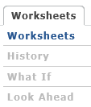
Worksheets Tab
Shows student’s current data/audit in “Worksheets”
Can see past audits run in “History”
Can run a What-If audit in “What If”
Can see an audit with expected future courses in “Look Ahead”

Slide 12
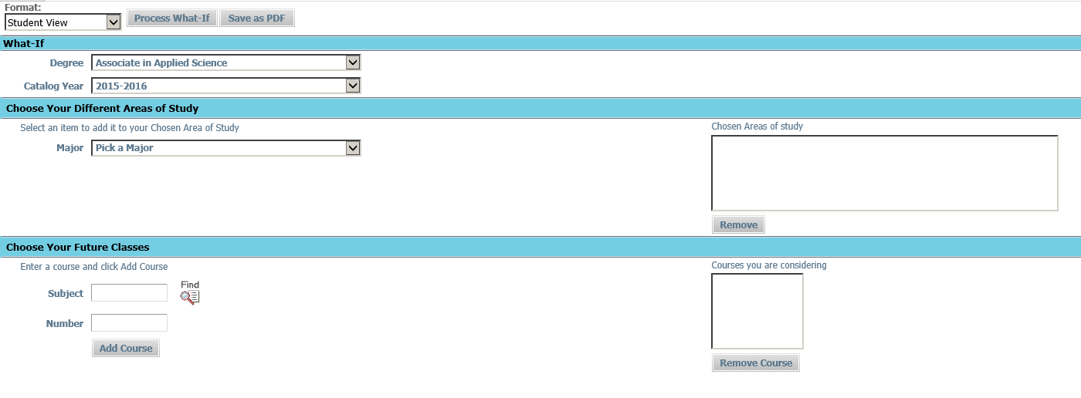
What-If Function
Located under the Worksheets tab
Allows students to explore other degree options and see how their completed courses could fulfill various degrees
From the drop down lists, choose a degree, catalog year, and major, then select “Process What-If” to run the audit

Slide 13
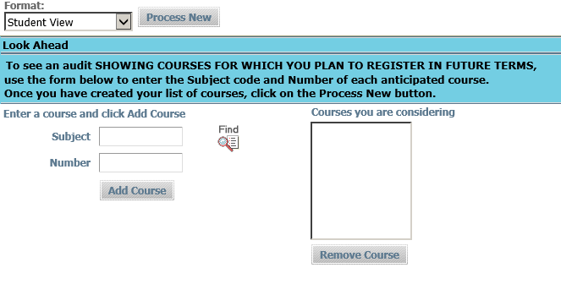
Look Ahead Function
Use this function to show courses for which you plan to register in future terms
Enter a course subject code in the Subject box, and a course number in the Number box
Select “Add Course” to add new courses to the audit
Click the “Find” icon if the subject code or course number are unknown
Once all courses have been added, select “Process New” to process the Look Ahead audit

Slide 14
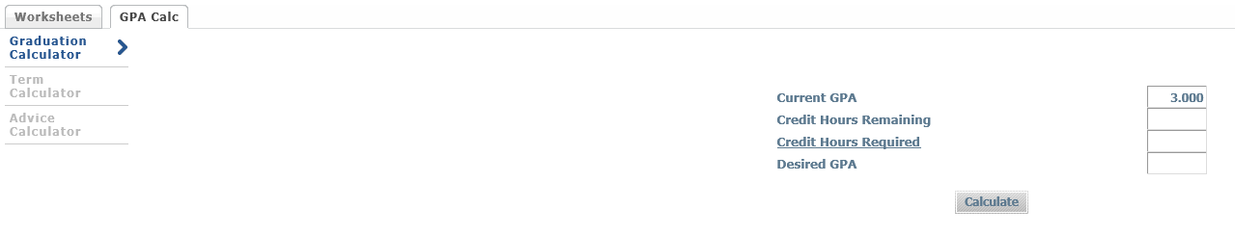
GPA Calculator Tab
Students can use the GPA (Grade Point Average) Calculator to view the following features:
  Graduation Calculator
  Term Calculator
  Advice Calculator

Slide 15
Graduation Calculator
Enter the number of remaining credits needed for graduation in the Credit Hours Remaining Box
Enter the number of required credits for degree completion in the Credit Hours Required Box
Enter the desired graduation GPA in the Desired GPA box
Select “Calculate”
A screen will appear with information regarding the necessary average GPA that will be required to meet the student’s graduation GPA goal
Select “Recalculate” to change input information and obtain a new GPA average

Slide 16
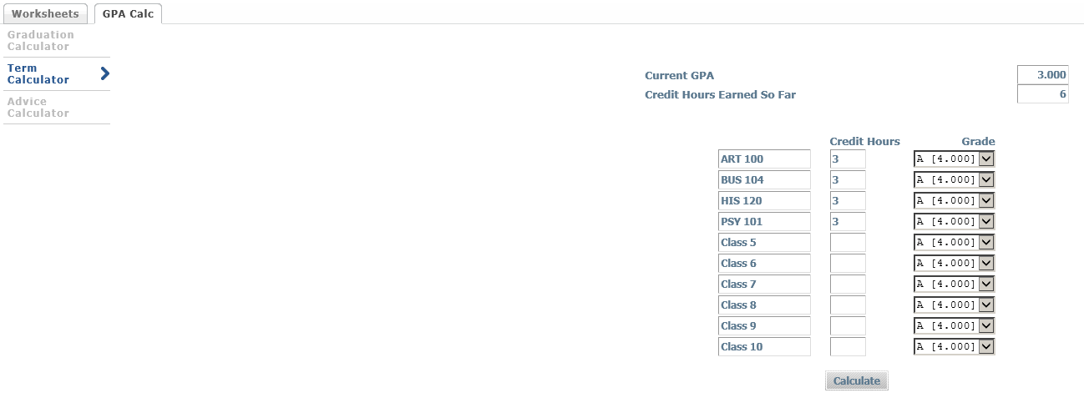
Term Calculator
Can be used to set goals and map paths to avoid probation
Enter the course code for each course in the Class boxes
Enter the number of credits for each course in the Credit Hours boxes
Use the Grade drop-down boxes to enter the expected grade in each class
Select “Calculate”
A screen will appear with the newly calculated GPA
Select “Recalculate” to return to the original screen and revise grade or class information

Slide 17
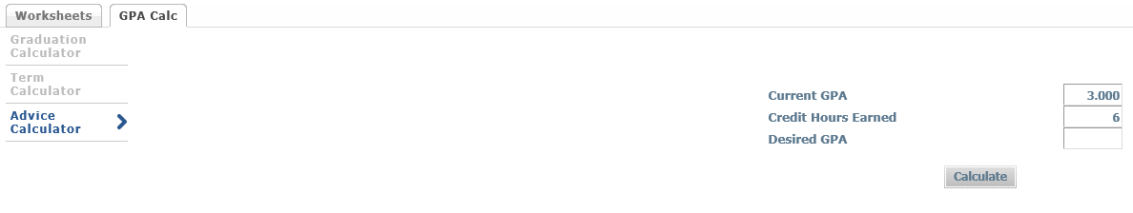
Advice Calculator
Can be used to figure out how to raise student’s GPA, using actual grades as advice
Enter a desired GPA in the Desired GPA box
Select “Calculate”
A screen will appear showing the average grade that will be needed to obtain the desired results
Select “Recalculate” to return to the original screen and revise information

Slide 18
For Additional Information or Assistance
Please contact Crystal Thomsen
in the Registrar’s Office
316-677-1747
cthomsen@watc.edu

