Slide 1
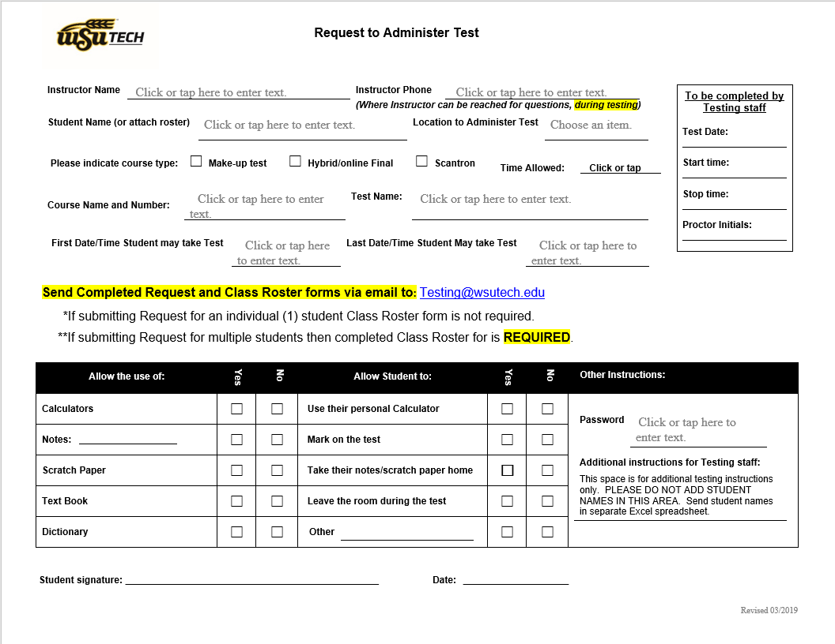
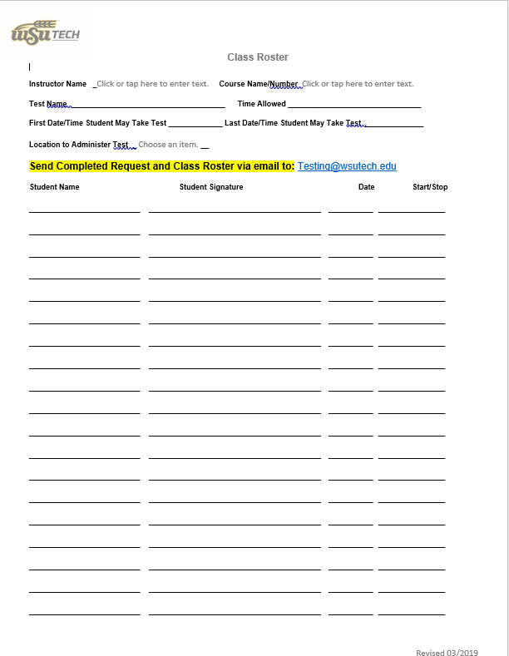

WSU Tech
Testing Services
How to Submit A Request to Administer Test

Slide 2

How to Access
Request to Administer Documents
Start by opening up the WSU Tech website. www.wsutech.edu.
At the top of the page there will be a gray banner bar. On this gray banner bar click on the myWSUTech link.

Slide 3

Log Into Your myWSUTech Portal
Enter your username and password. Then click Login.

Slide 4
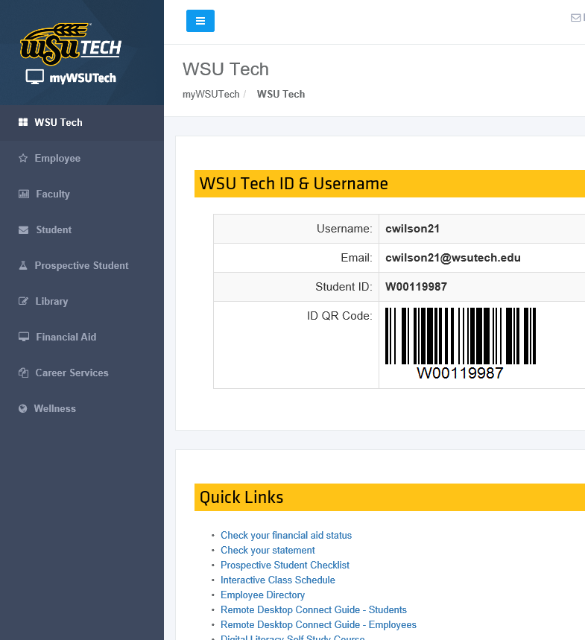
Faculty Tab
Once you are in your myWSUTech you will click on the “Faculty” tab in the gray column on the left side of the page.

Slide 5
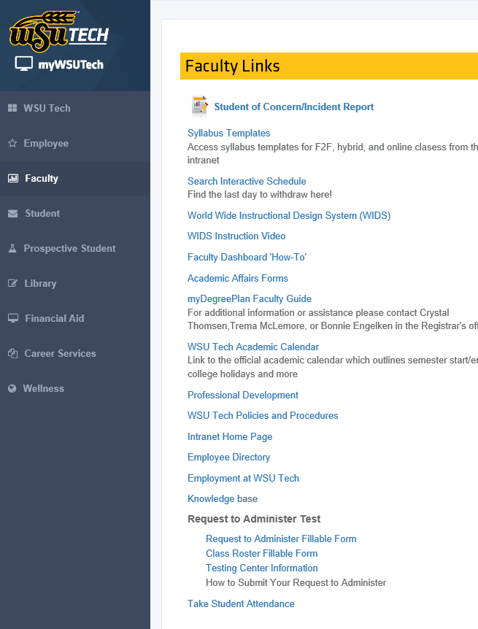
Request to Administer Test
Within the “Faculty” tab you will find the “Request to Administer Test” links.
To complete your Request to Administer Test you will need to access both the “Request to Administer Fillable Form” and the “Class Roster Fillable Form”.
Simply click on the links and the necessary forms will open up.

Slide 6
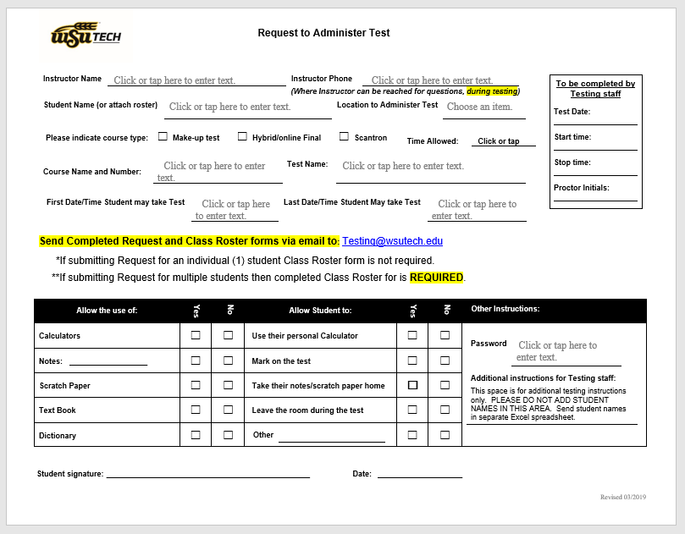
Request to Administer Fillable Form
After clicking the “Request to Administer Fillable Form” link, the fillable form will open up.
You will need to complete this form, and email it to Testing Services at Testing@wsutech.edu.
Next you will need to complete the “Class Roster Fillable Form”.

Slide 7
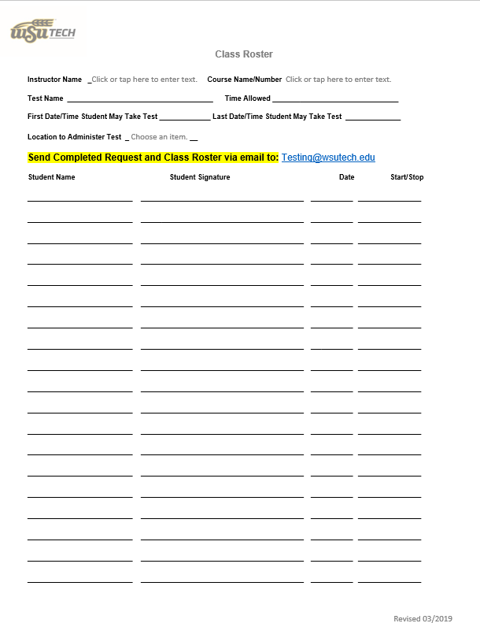
Class Roster Fillable Form
If you are submitting a “Request to Administer Fillable Form” for an individual student (1 student), then you do not need to complete a “Class Roster Fillable Form”.
For multiple students you will need to complete a “Class Roster Fillable Form”.
Email the completed “Request to Administer Fillable Form”, along with the completed “Class Roster Fillable Form” to Testing Services at Testing@wsutech.edu.

Slide 8

All Request to Administer and Class Roster forms must be submitted through the Testing Services email at Testing@wsutech.edu.
Handwritten Request to Administer and Class Roster forms will not be accepted by the Testing Center.
Incomplete Request to Administer and/or Class Roster forms will be returned to instructors.

