Slide 1


Slide 2



IMAGINE SUCCESS
Re-Accreditation of Surgical Technology and Auto Tech
Manufacturing Day
President Fox’s (former President of Mexico) visit
Opening of Veteran’s Centers
Remodel of Grove Auto and HVAC labs
Award of Title III grant - $2,250,000 five year grant for healthcare
Fiat-Chrysler – MOPAR CAP (Career Auto Program) designation
Fall Credit hours up .5% from last fall
New Assessment Plan for all programs
317 students started the Shocker Pathway (254 indicated they plan to pursue a four year degree)
Awarded $130,000 of institutional scholarship dollars to 179 students
Default management contract has resulted in a reduction of 1.3%
Completion of Strategic Plan – Vision 2020

Slide 3
VISION 2020
Hedgehog Statement:
WATC is the recognized leader in providing open access, affordable higher education, and industry-driven career and technical training.

Slide 4
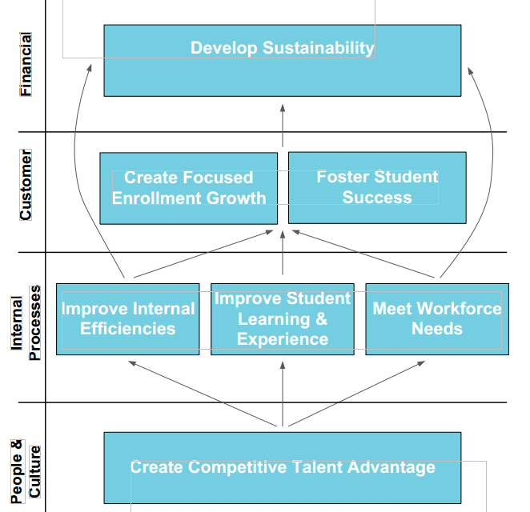
VISION 2020
Strategy Map

Slide 5
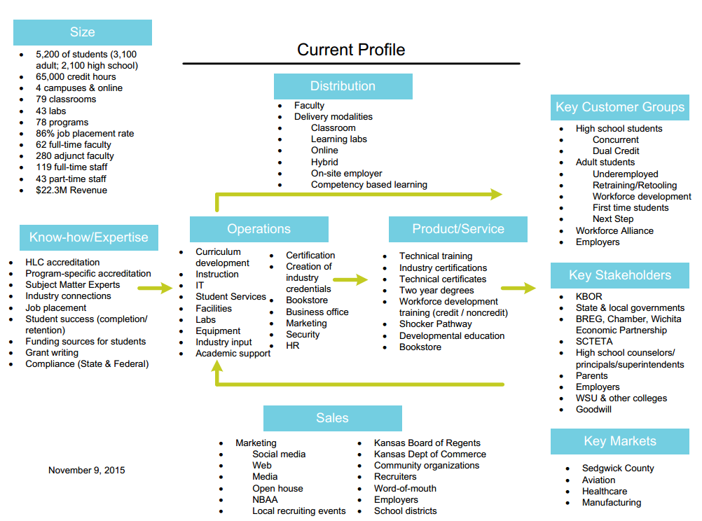
VISION 2020
Current Profile

Slide 6
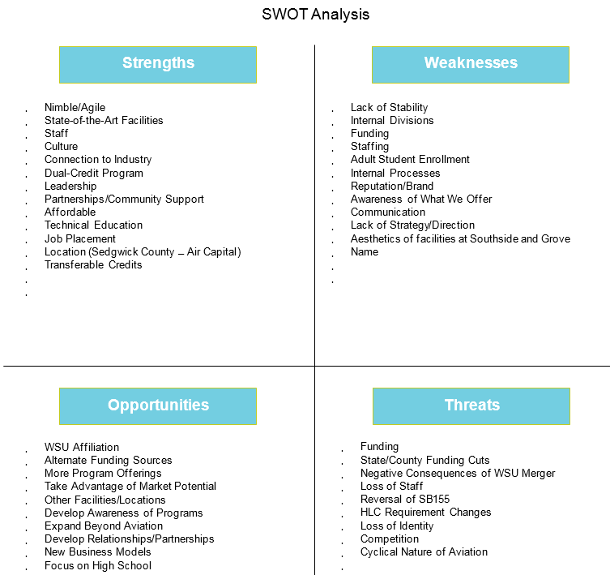
VISION 2020
SWOT Analysis

Slide 7
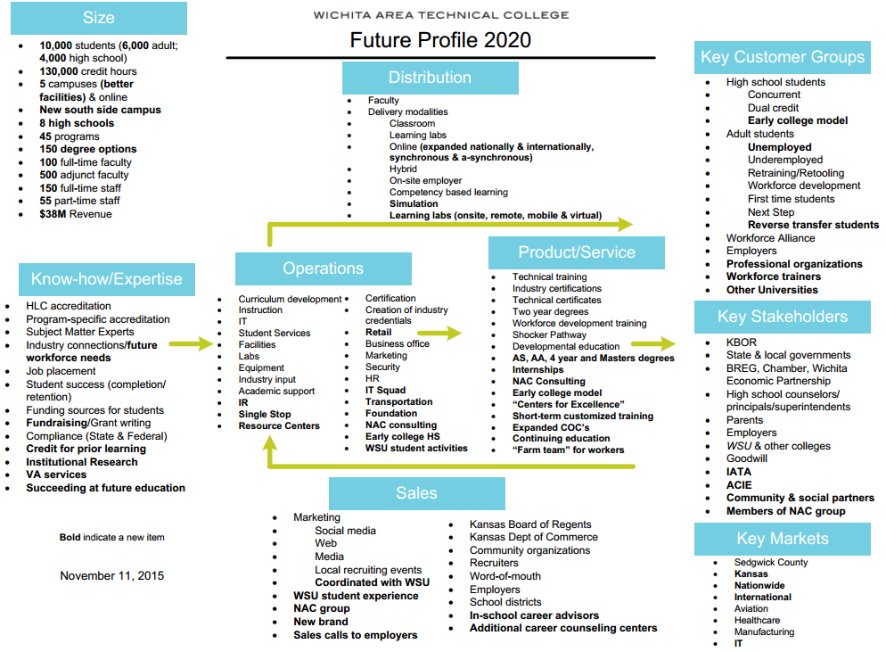
VISION 2020
Future Profile

Slide 8
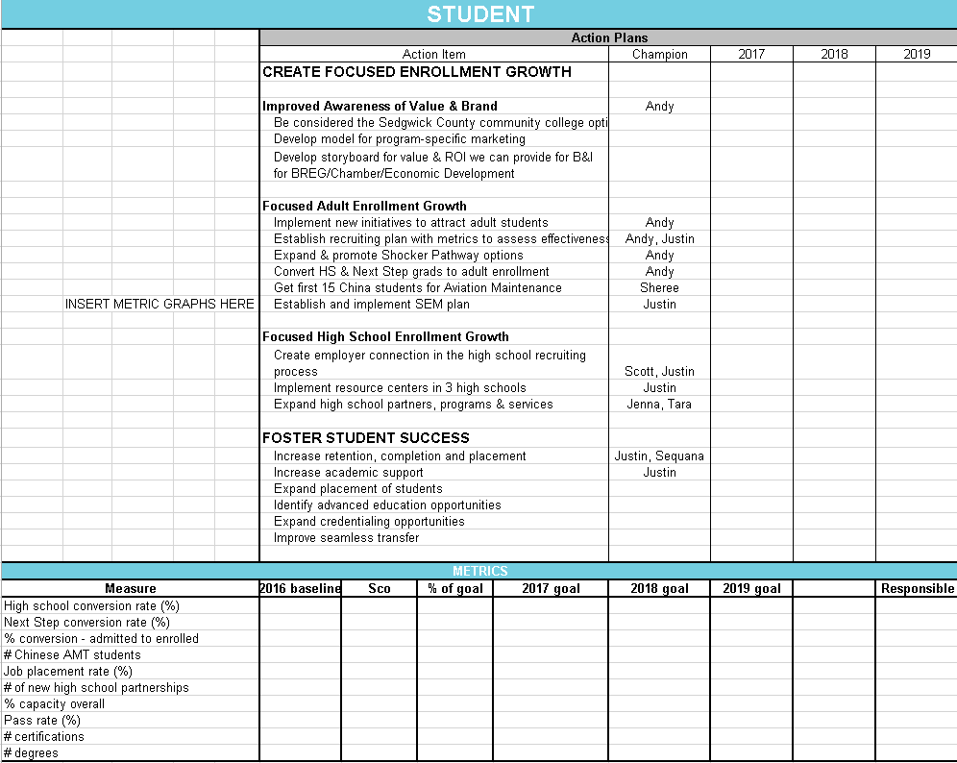
VISION 2020
Scorecard

Slide 9
Financial Update
Unqualified opinion on FY2015 audit by BKD (“clean audit”)
Opportunity for improvement in internal control weaknesses (not deemed material by BKD)

Slide 10
Utash’s 15 Keys to Success
Commitment
Unselfishness
Unity
Be Resilient
Improve
Self-Discipline
Great Effort
Enthusiasm
Eliminate Mistakes
Never Give Up
Don’t Accept Being Average
Responsibility
Consistency
Leadership
Imagine and Expect Success

